Slide 1

Zowe Joint Community 20PI3 (Q3) Context & Vision
Presenters: Sujay Solomon, Bruce Armstrong, Peter Fandel Mark Ackert, Joe Winchester, Sean Grady, Michael Bauer
Notes:
Speaker - ?

Slide 2
Notes
PI planning facilitators (Kyle, Nick, Nolan) will be sharing a quick 5 min PI planning intro and a PI planning event agenda before we (ZLC) present the context / vision (separate ppt)
Following our presentation, the squad leads will present specific features in focus for their individual squads (separate ppt)

Slide 3
Agenda
Why Joint PI planning for Zowe?
Zowe Deliverables and achievements from last PI
Community highlights from last PI
New incubation sub-projects in Zowe and updated Zowe Landscape
Zowe Today & Future
Zowe Squad Updates
Hills for Zowe Community in the upcoming PI
ZLC Focus for upcoming PI
Notes:
Speaker - Sujay

Slide 4
Why Joint PI Planning for Zowe?
Notes:
Speaker - Bruce

Slide 5
Why Joint PI Planning?
Zowe consists of several important technologies – integration of those technologies is a critical value proposition of the project
PI planning is an opportunity for Zowe squads to work together in aligning development to users’ needs with the community context, vision, and PI objectives.
Enable more cross-squad synergy
Bring clarity and focus to squad members from different organizations
Identify dependencies across squads
Open up the planning process to community in the spirit of a true open source project
Avoid duplication of code across squads
Notes:
Speaker - Bruce

Slide 6
What did we deliver last PI?
Notes:
Speaker - Joe

Slide 7
Achievements
SSO & MFA across all Zowe components
API ML
API ML SAF Keyring support
“Try-it-now” - allow API testing within API Catalog
Improve static API onboarding
App Framework:
SAF Keyring support
Desktop Personalization
SSO Support
Notes:
Speaker – Joe | Peter (backup)

Slide 8
Achievements
CLI
CLI SSO and MFA integration with API ML
Alternate code page support for CLI datasets / USS Files
Zowe Explorer
Migrate and Recall datasets
List VSAM datasets
Star icon for favorites
Create, Add, Validate, Edit, Hide, and Delete profiles within the Zowe Explorer
Code Page support based on profile encoding field
Internal: Testing & code quality improvements
Notes:
Speaker - Joe | Peter (backup)

Slide 9
Achievements
Onboarding
V1 Conformance Program launched
Test Criteria revised to reflect LTS Features, “tagged” with “LTS” #, and migrated to Github
Terms and Conditions modified to retain badges
Badge Revision - “2019” discontinued, “V1” introduced
Zowe added to open mainframe project page on Wikipedia
CI/CD
Zowe Releases: 1.10, 1.11, 1.12
Infrastructure: Marist hosted Top Secret and ACF2 systems available
Pipelines: Zowe install & test builds migrated to Ansible
Pipelines: Smoke/Integration test framework refactored for improved dev experience
Notes:
Speaker - Joe | Peter (backup)

Slide 10
Achievements
Doc
Expanded and restructured the Zowe Explorer documentation.
Enriched troubleshooting information. Improved process for gathering troubleshooting content from Slack issues and resources section zowe docs.
Refactored the Download section on zowe.org.
Notes:
Speaker - Joe | Peter (backup)

Slide 11
Community Highlights

Slide 12
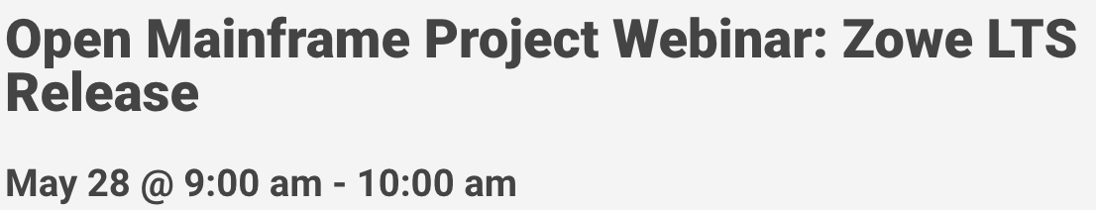
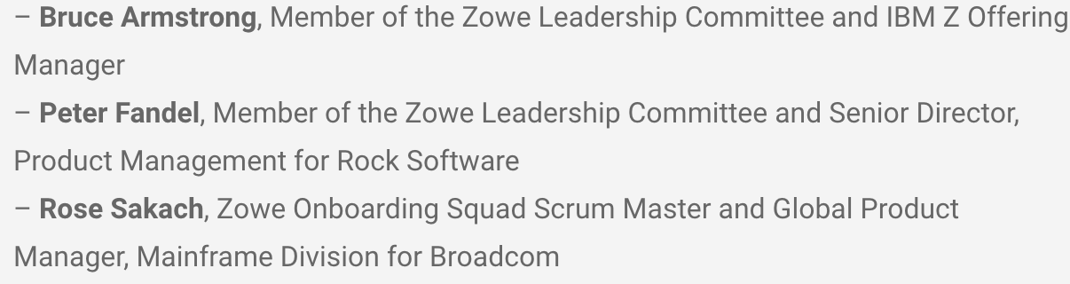
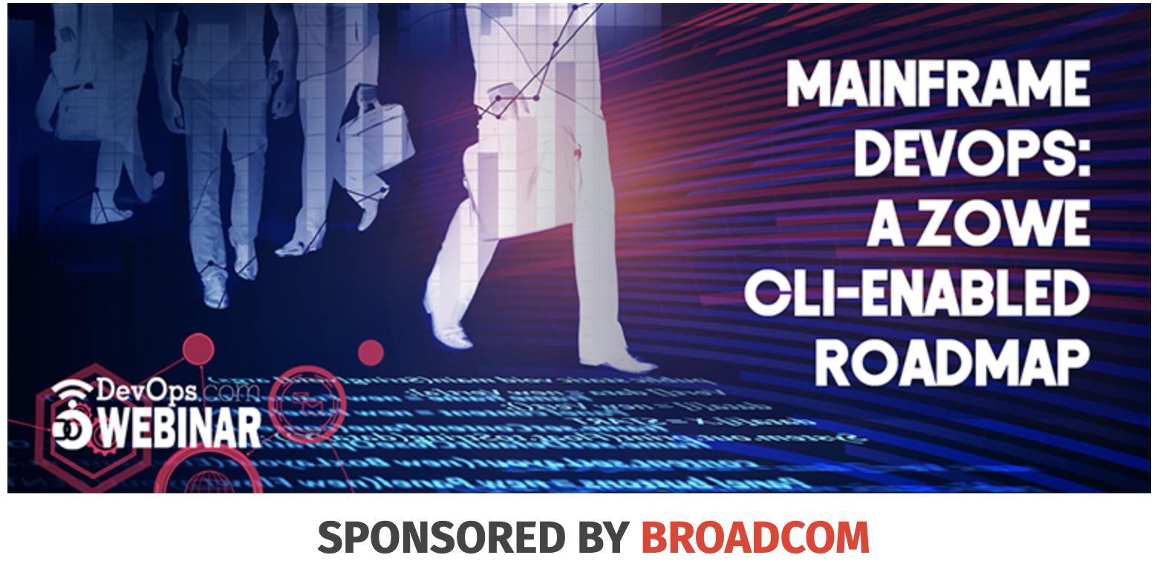
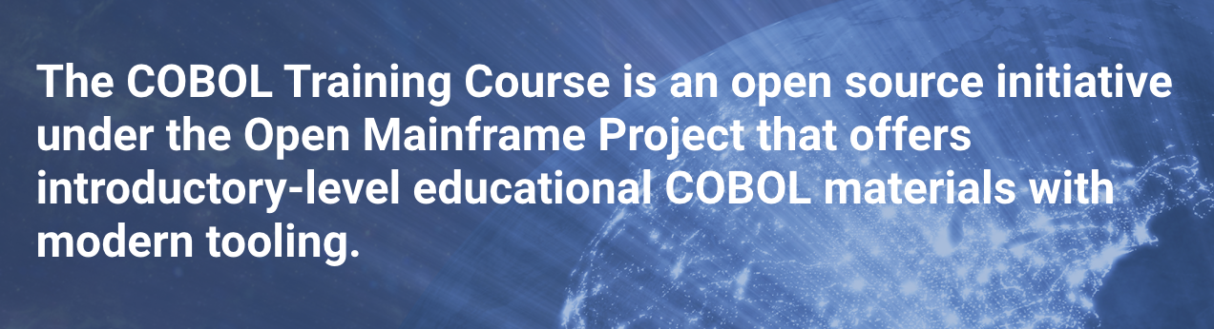

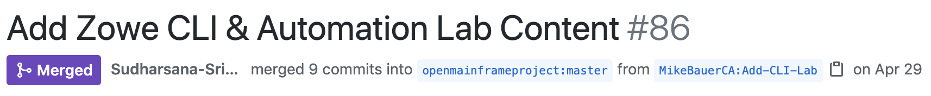

https://www.youtube.com/watch?v=zIPzaQK2bfU&t=2s
3 Innovations from HCL, IBM and Broadcom – all get complimentary invitations to the Open Mainframe Summit
Hosts: Joe Winchester (ZLC Member) & Jordan Cain (API ML Squad) Attendees: 330
Recording . Demo videos available on Youtube .
Hosts: Sujay Solomon (ZLC Member) & Mike Bauer (CLI Squad) Attendees: 155
Recording
Notes:
Speaker: Bruce

Slide 13
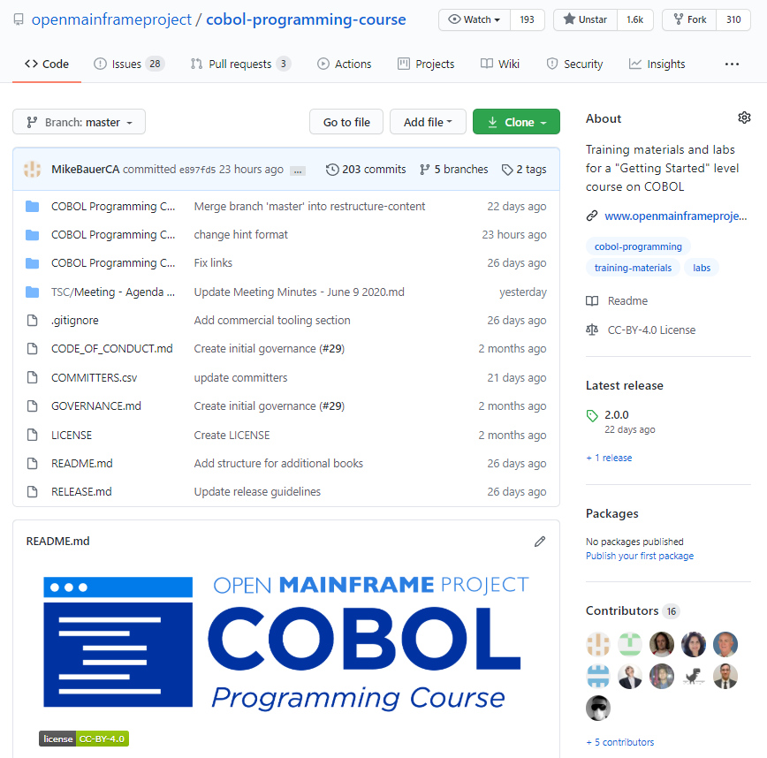
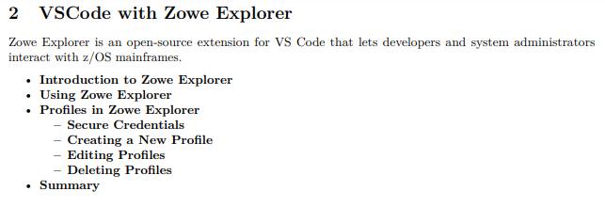
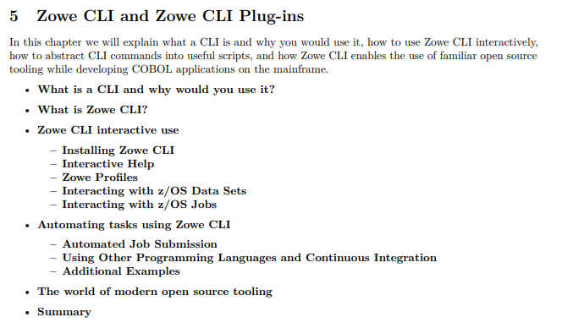
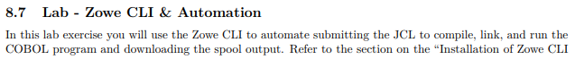
Zowe in OMP Cobol Training Course
Notes:
Speaker: Mike B (tentative)

Slide 14
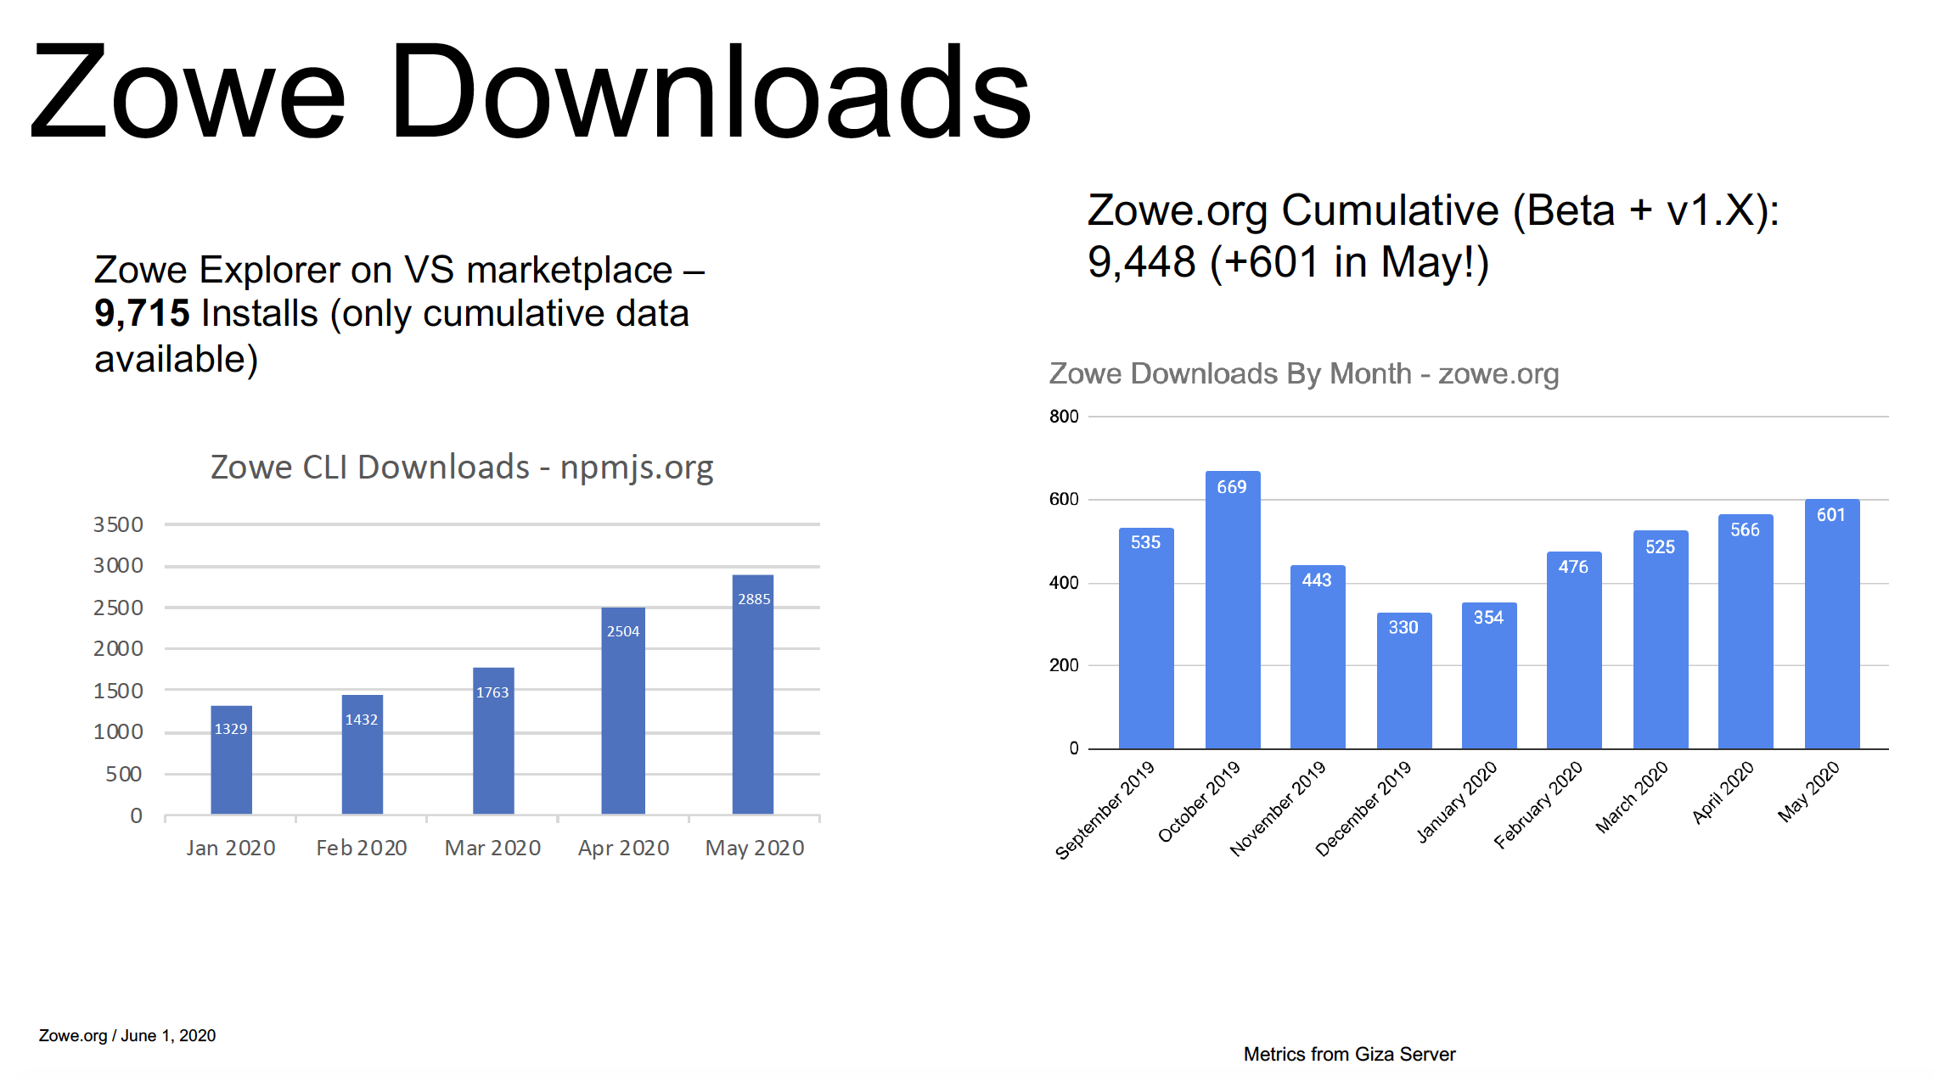
Notes:
Speaker: Bruce

Slide 15
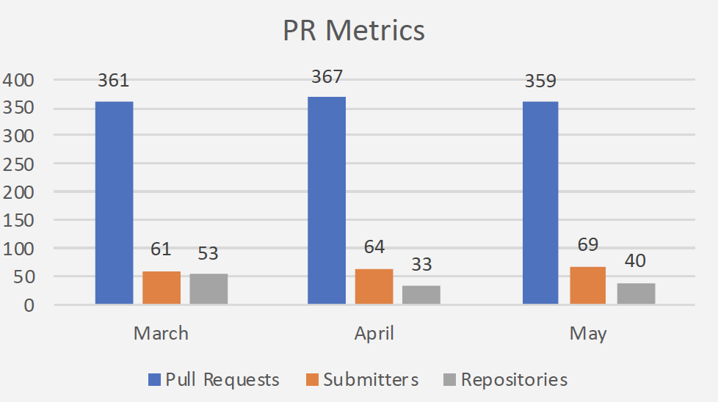
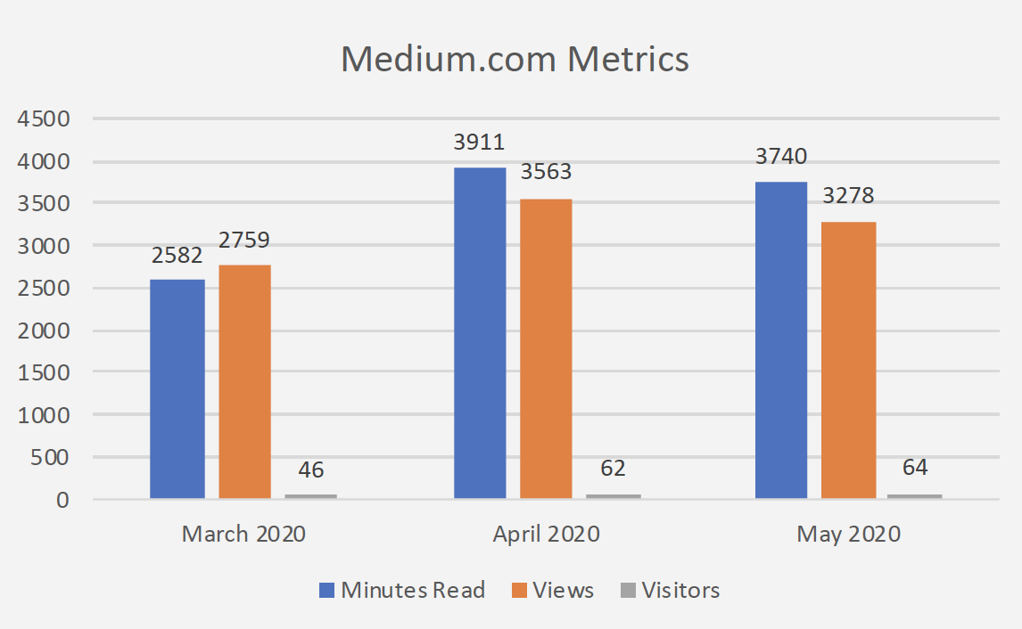

Average visitors/day
Notes:
Speaker: Bruce

Slide 16
New incubation sub-projects in Zowe and updated Zowe Landscape

Slide 17
Zowe Mobile – Incubation Sub-Project
https://github.com/zowe/zowe-on-the-go - The Zowe Mobile Application lets you interact with your Zowe services integrated with the Zowe API Mediation Layer.
Incubating in the App Framework Squad
Notes:
Speaker: Sujay

Slide 18
Zowe Client SDK – Incubation Sub-Project
Zowe Client SDK is a set of programming libraries targeting specific languages to offer a better programming experience for developers who wish to integrate Zowe base and conformant services into their application. The Zowe Client SDKs offer consistent and language-specific access to REST APIs on z/OS that are integrated with the Zowe API Mediation Layer. Developers will be able to import the appropriate language Zowe Client SDK into their project and avoid the complexities of coding to REST APIs directly.
Incubating in the CLI Squad
Zowe Client SDK (Incubation*)
Notes:
Speaker: Sujay

Slide 19
Zowe Today & Future

Slide 20
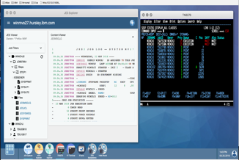
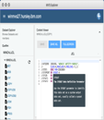
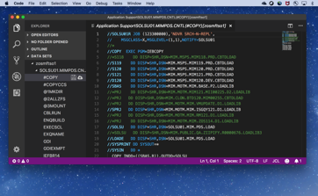
Zowe - Today
Ravi (DevOps)
Michelle (App Dev)
Tyler
(System Administrator)
Isabelle (Operator)
Zowe App Framework Browser GUI
Zowe Mobile App (Incubation*)
Zowe Explorer
Code Editor Extension
Zowe CLI build | deploy | test
Apps
Extensions**
CODE
DEPLOY
Plugins
PLAN
BUILD
RELEASE
OPERATE
TEST
MONITOR
Packages
Zowe Client SDK (Incubation*)
API Mediation Layer
*Incubation sub-projects are research and prototypes not ready for general consumption
**Extensibility of Zowe Explorer is in development
Microservices
Notes:
Speaker: Sujay

Slide 21
Zowe - Future
Ravi (DevOps)
Michelle (App Dev)
Tyler
(System Administrator)
Isabelle (Operator)
Zowe App Framework Browser GUI
Zowe Mobile App (Incubation*)
Zowe Explorer
Code Editor Extension
Zowe CLI build | deploy | test
Apps
Extensions**
Plugins
CODE
DEPLOY
PLAN
BUILD
RELEASE
OPERATE
TEST
MONITOR
Packages
Zowe Client SDK (Incubation*)
API Mediation Layer
*Incubation sub-projects are research and prototypes not ready for general consumption
**Extensibility of Zowe Explorer is in development
Microservices
Notes:
Speaker: Sujay

Slide 22
Zowe Squad Updates

Slide 23
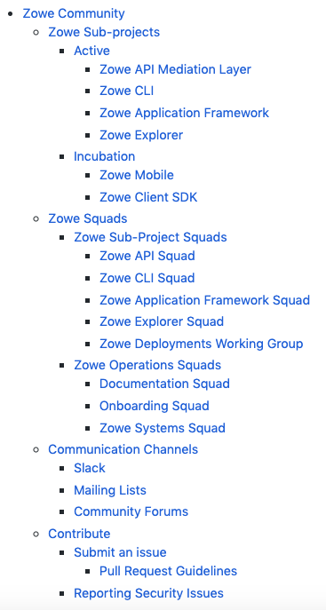
Sub-Projects & Squads
https://github.com/zowe/community
Squad Updates
Renamed CI/CD Squad → Systems Squad with an updated charter
CLI Squad added Zowe Client SDK Incubation to charter
App Framework Squad added Zowe Mobile Incubation to charter
New Squads / Workgroups
Zowe Explorer Squad
Deployments Workgroup
Notes:
Speaker: Mark

Slide 24
Hills for Zowe Community – Upcoming PI

Slide 25
High Availability / Resilience
As a z/OS System Programmer I can configure Zowe z/OS Components to deliver its services through a Highly Available endpoint, using familiar practices and technology.
Subhill:
As a zOS System Programmer I am able to use familiar console automation offerings to run, configure, and monitor Zowe z/OS components.
Notes:
z/OS native services = z/OS Sysplex Distributor and/or cross-LPAR shared file systems
Zowe direct use of the Z coupling facility is outside the scope of this hill – i.e., not required
This hill is for 2H2020 as Zowe container strategy is established and how containers may be managed for HA in the future
Notes:
Speaker: Peter

Slide 26
Zowe Explorer
As a Zowe Extender, I want to be able to develop Zowe Explorer extensions following a well-defined API with documentation, examples, and conformance criteria so that I can quickly make extensions and have confidence about gaining a conformance badge.
Considerations:
Does this cover the implementation neutral interface to back ends, e.g. z/OSMF/RSE/FTP/other… switching ?
Does this cover the implementation for menu extensions (e.g. Data Set menu extensions) so that offerings like HCL Z Tools, Broadcom Data Tools, other… have conformance ? What else is there – JES, debug, USS, … ?
Notes:
Speaker: Sujay

Slide 27
Zowe Client SDK
As a software developer, I want a Node.js software development kit (SDK) that my code can depend upon for accessing z/OS services, so that I do not have to worry about differences in service implementation or environment except when the details actually matter to me.
Stretch: The Zowe Client SDK should allow for scope beyond node.js to cover programming languages such as Python, Java, and others to come.
Considerations:
Do we distribute this on npmjs.org ?
Is this covered by Zowe LTS and is it included in Zowe core
Notes:
Speaker: Sujay

Slide 28
“Deployments” Working Group
As a z/OS System Programmer I can manage extensions to Zowe in a reliable, repeatable and consistent manner across conformant offerings, through download, install, configure into an existing Zowe instance, auditability of which extensions are active, upgrade, uninstall
As a z/OS conformant extension I can package my offering in a way that z/OS system programmers can download and install/extend/configure their existing Zowe instances in a consistent way.
Stretch: As a Zowe community I can deliver z/OS conformance extensions on Zowe.org and provide a marketplace experience for conformant offerings and z/OS system programmers
Stretch: As a z/OS System Programmer I have a zowe command through which I can control and administer Zowe, covering instance directory catalog, controlled shutdown and other admin commands
Notes:
Speaker: Joe | Bruce (backup)

Slide 29
“Deployments” Working Group
Containerization / Hybrid Topology
As a Zowe developer I can download, configure and launch a container with the Unix portion of Zowe on a native Unix OS, connected to a z/OS system containing the native z/OS components, and operate in a hybrid topology.
Spike:
As a customer administrator I can download the container and deploy this into a unix environment connected to my native z/OS components and use this for runtime as part of the LTS release.
Notes:
Do we use docker – what alternatives if not ?
Do we pre-req AT/TLS for securing the ZSS http:// server ? Do we pre-req the gateway to secure it ? Do we add https:// to zss ?
Deliver a beta in this PI
Notes:
Speaker: Joe | Bruce (backup)

Slide 30
Foundation
Continue to build on the security theme of PI2, to support authentication using client side certificates.
Simplify administration of CLI profiles so a single Zowe profile that connects to APIML can be used to provide centralized management of z/OS endpoints through a client CLI.
Notes:
Speaker: Joe | Bruce (backup)

Slide 31
Foundation
Theme | Items | Questions | Squad
Serviceability | Binary on z/OS for find Zowe and release levels installed - Start/stop - Clean shutdown |  | Deployments Workgroup
Zowe.org usability improvements | - Comments from those interested in joining the community that cite difficult to navigate for new contributors (tailored for Zowe consumers) | Designer help | Doc Squad
Integrate Performance Testing into CI/CD | Ensure performance tests from all Zowe components are integrated into automated pipelines. Ensure target environments can support performance tests. | Needs to answer “what is Zowe’s expected resource utilization?” Provide clarity on what performance behavior is inherited from z/OSMF | CI/CD
Notes:
Speaker: Joe | Bruce (backup)

Slide 32
ZLC Focus for upcoming PI

Slide 33
ZLC Focus
Zowe Support Offering Conformance
What is Zowe core and how can someone claim support for it ?
How do OMP managed Zowe extensions (CLI, APIML) fit in
Drive outreach to gather more usage data/trends

Slide 34
Thank You

Slide 35
Appendix

Slide 36
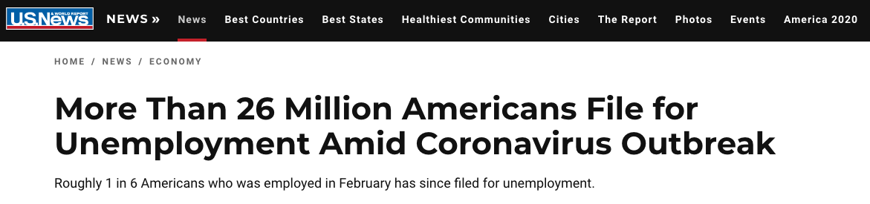
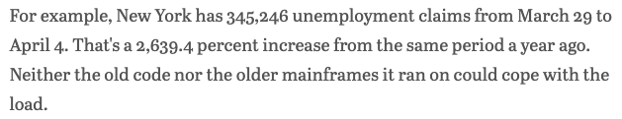
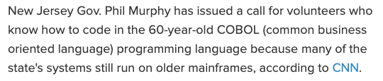
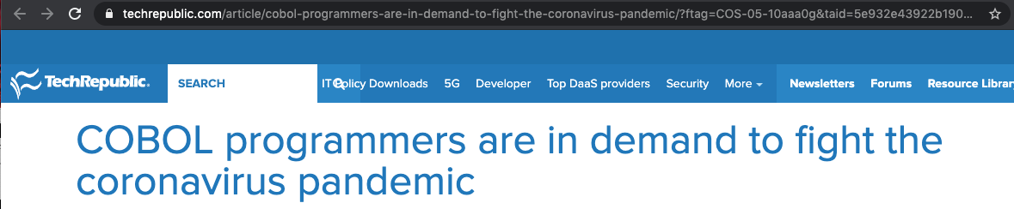
Notes:
Equivalent to the entirety of Pennsylvania, Rhode Island, South Carolina, South Dakota and Tennesse filing for unemployment in just a five-week span

Slide 37
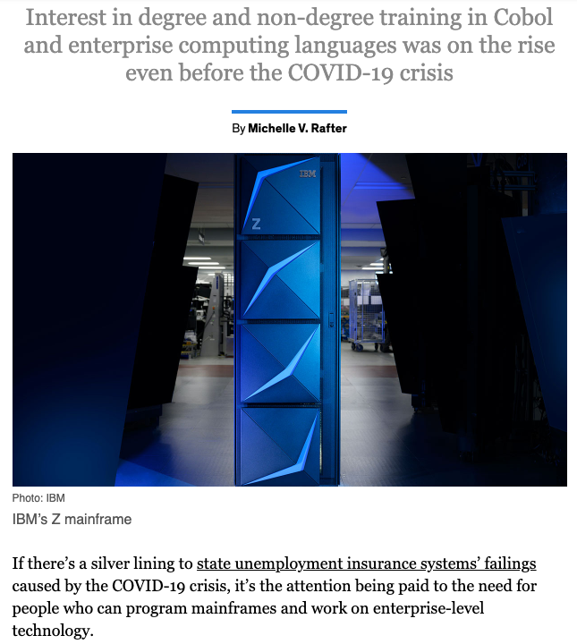
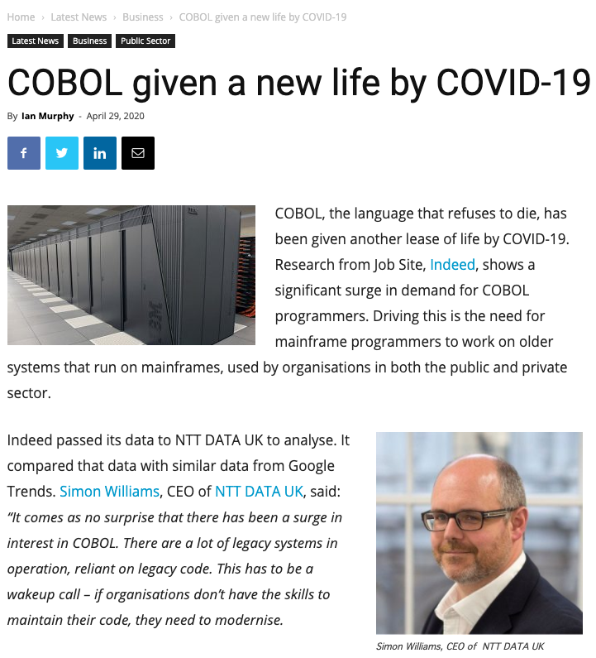
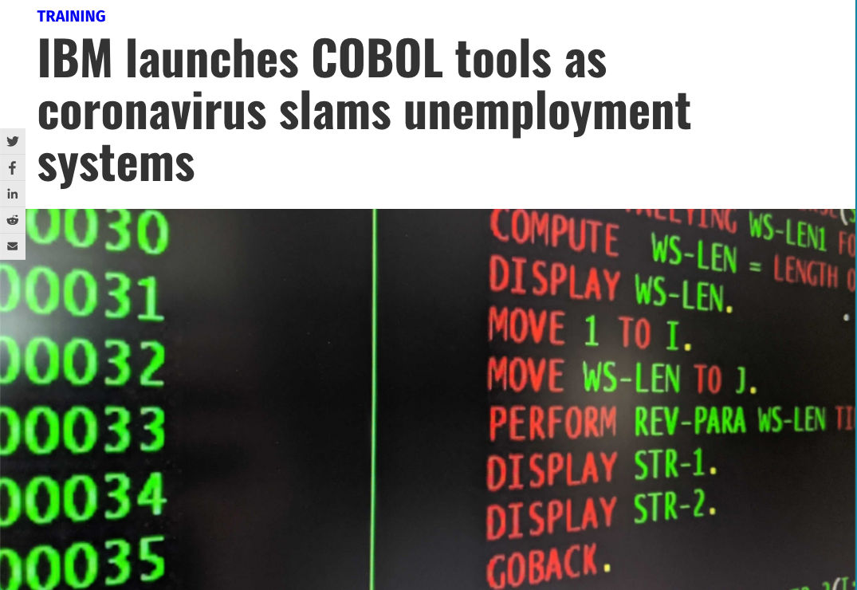
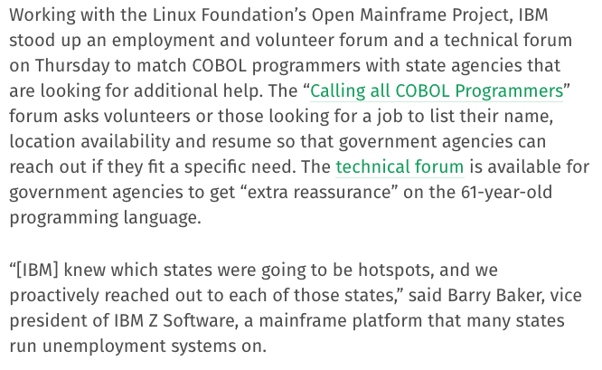
The right place at the wrong time

Slide 38
